Slide 1
Objective: Add and Subtract Polynomials
7-7

Slide 2
7-7
In order to add or subtract you must have like terms.
Recall-
Like terms are pieces that have the same variable(s) and same exponents attached to those variables.

Slide 3
7-7
Like terms:
2x, 4x, -3x
7xy, xy, -8xy
4ab², 10ab², -ab²
NOT like terms:
6x, 7y
8x², 8x
ab², ab³

Slide 4
7-7
You must get rid of parenthesis by distributing the sign BEFORE combining like terms!

Slide 5
7-7
Find each sum or difference. Then put in descending order!
1. (a³ – 4b²) + ( 2a³ + 5a² – 6b² + 4b³)
3a³ + 4b³ + 5a² -10b²
2. (2r – 8s) – (8r + 3s)
-6r – 11s

Slide 6
7-7
Find each sum or difference. Then put in descending order!
3. (4x² – 7x⁴) + (2x⁴ + 5x² – 6 + 4x³)
-5x⁴ + 4x³ + 9x² - 6
4. (2c² – 9) – (4c² – 4c + 1)
-2c² + 4c - 10

Slide 7
7-7
Find each sum or difference. Then put in descending order!
5. (3ab² + 6ab + 8) + (-2ab² + 2ab – 8)
ab² + 8ab
6. (ax² + 8ax) – (9 + 8ax² – 2ax)
-7ax² + 10ax - 9

Slide 8
7-7
Find each sum or difference. Then put in descending order!
7. (3x² + 6y + 3) + (-2x² + 2y – 8)
x² + 8y - 5
8. (2w – 5xy) – (8w + 3xy)
-6w – 8xy

Slide 9
7-7
Find each sum or difference. Then put in descending order!
9. (-14a² – 3ab +9) – (5a² + 4ab + 1)
-19a² – 7ab + 8
10. (10mn⁴ + 2mn³) – (9mn + 8mn³ –mn⁴)
9mn⁴ – 6mn³ – 9mn

Slide 10
7-7
2x + 3
4x + 8
(4x + 8) + (2x + 3) + (4x + 8) + (2x + 3)
12x + 22

Slide 11
7-7
15x
10x - 3
10x - 3
15x
(15x) + (10x – 3) + (15x) + (10x – 3) =
50x – 6
If perimeter is 2 then:
50(2) – 6
= 94 yards

Slide 12

7-7
The sum of two trinomials is: $4x^{2}+3x+1$. One trinomial is $x^{2}+x−4$. The other trinomial is:
${ 5x}^{2}+4x−3$
${3x}^{2}+4x−3$
${3x}^{2}+2x+5$
${5x}^{2}+4x+5$

Slide 13
7-7
The sum of two triomials is: $−2x^{2}−2x+3$. One trinomial is: ${−x}^{2}+3x+1$. The other trinomial is:
$−3x^{2}+x+4$
$−x^{2}−5x+2$
${−x}^{2}+x+4$
$−3x^{2}+x+2$

Slide 14
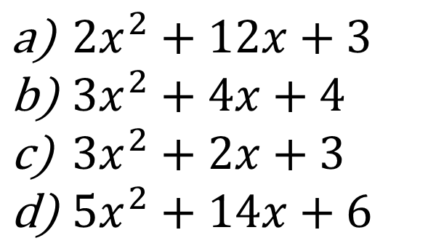
7-7
The perimeter of this triangle is:
$5x^{2}+14x+6.$What is the length of the third side?
$$2x^{2}+4x+1$$
$$8x+2$$
$2x^{2}+12x+3$
$3x^{2}+4x+4$
$3x^{2}+2x+3$
$5x^{2}+14x+6$

