Slide 1
Solve problems involving exponential growth and decay.

Slide 2
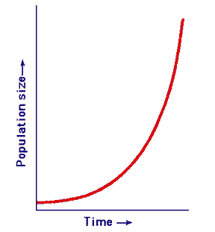
Exponential growth occurs when an amount (i.e. money) increases by the same rate in each time period.
If something grows
exponentially it grows
quicker and quicker.

Slide 3
EXPONENTIAL GROWTH
Original
amount
Time
Final
amount
Rate of growth (decimal)

Slide 4
EXPONENTIAL GROWTH
In exponential GROWTH the piece in the parenthesis will always be bigger than 1.

Slide 5
Review:
Percents are a FRACTION out of 100!
To change a percent into a decimal divide by 100.

Slide 6
Examples:
The original value of a painting is $9,000 and the value increases by 7% each year. Write an exponential growth function to model this situation.
Then find the painting’s value in 15 years.

Slide 7
Examples:
2. A sculpture is increasing in value at a rate of 8% per year, and its value in 2000 was $1200. Write an exponential growth function to model this situation.
Then find the sculpture’s value in 2006.

Slide 8
Examples:
3.
Annual sales for a clothing store are $270,000 and are increasing at a rate of 7% per year. Write an exponential growth function to model this situation.
Then find the total sales after 3 years.

Slide 9
Examples:
4. The number of employees at a certain company is 1440 and is increasing at a rate of 1.5% per year. Write an exponential growth function to model this situation.
Then find the number of employees in the company after 9 years.

Slide 10
5)
Use the equation to answer the following questions.
1.8
What is the growth factor? ______________
What is the rate (%) of growth? ___________
What is the initial value? ______________
80%
12

Slide 11
6)
Use the equation to answer the following questions.
1.04
What is the growth factor? ______________
What is the rate (%) of growth? ___________
What is the initial value? ______________
4%
1

Slide 12
7)
Use the equation to answer the following questions.
1.35
What is the growth factor? ______________
What is the rate (%) of growth? ___________
What is the initial value? ______________
35%
6

Slide 13
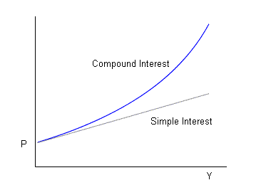
A common application of exponential growth is: compound interest.
Simple interest is earned or paid only on the original amount (principal). LINEAR!
Compound interest is interest earned or paid on both the original amount (principal) and previously earned interest.
EXPONENTIAL!

Slide 14
COMPOUND INTEREST
Interest Rate
(decimal)
Original amount (Principal)
Time
(years)
Balance after
t years
# of times interest is compounded per year

Slide 15
Reading Math
For compound interest
annually means “once per year” (n = 1).
quarterly means “4 times per year” (n =4).
monthly means “12 times per year” (n = 12).

Slide 16
Examples: Write a compound interest function to model each situation.
8. Find the balance after 3 years: $1200 invested at a rate of 2% compounded quarterly.

Slide 17
Examples: Write a compound interest function to model each situation.
9. Find the balance after 2 years: $15,000 invested at a rate of 4.8% compounded monthly.

Slide 18
Examples: Write a compound interest function to model each situation.
10. Find the balance after 4 years: $1200 invested at a rate of 3.5% compounded quarterly.

Slide 19
Examples: Write a compound interest function to model each situation.
11. Find the balance after 8 years: $4000 invested at a rate of 3% compounded monthly.

Slide 20
Day #2
Exponential Decay

Slide 21
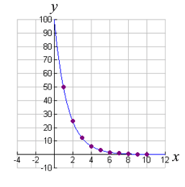
Exponential decay occurs when a quantity decreases by the same rate in each time period.
If something decays
exponentially it gets smaller
quicker and quicker.

Slide 22
EXPONENTIAL DECAY
You may add this to your formula sheet!
Original
amount
Time
Rate of growth (decimal)
Final
amount

Slide 23
EXPONENTIAL DECAY
In exponential DECAY the piece in the parenthesis will always be a decimal.
(Because you are subtracting “r”.)
Because it is a decimal your function is getting smaller and will curve DOWN!

Slide 24
Notice an important difference between exponential growth functions and exponential decay functions:
For exponential growth, the value inside the parentheses will be greater than 1 because r is added to 1.
For exponential decay, the value inside the parentheses will be less than 1 because r is subtracted from 1.

Slide 25
12. The population of a town is decreasing at a rate of 3% per year. In 2000 there were 1700 people. Write an exponential decay function to model this situation.
Then find the population in 2012.

Slide 26
13. The fish population in a local stream is decreasing at a rate of 3% per year. The original population was 48,000. Write an exponential decay function to model this situation.
Then find the population after 7 years.

Slide 27
14. The deer population of a game preserve is decreasing by 2% per year. The original population was 1850. Write an exponential decay function to model the situation.
Then find the population after 4 years.

Slide 28
15. The population of a school is 800 and is decreasing at a rate of 2% per year. Write an exponential decay function to model the situation.
Then find the population after 4 years.

Slide 29
A common application of exponential decay is the half-life of a substance.
This is the time it takes for one-half of the substance to decay into another substance.

Slide 30
HALF-LIFE
# of half lives in given time period
Final Amount
Original Amount
You may add this to your formula sheet!

Slide 31
16. Astatine-218 has a half-life of 2 seconds. Find the amount left from a 500 gram sample of astatine-218 after 10 seconds.

Slide 32
17. Astatine-218 has a half-life of 2 seconds. Find the amount left from a 500-gram sample of astatine-218 after 1 minute.
(Hint: Change 1 minute to second.)

Slide 33
18. Cesium-137 has a half-life of 30 years. Find the amount of cesium-137 left from a 100 milligram sample after 180 years.

Slide 34
19. Bismuth-210 has a half-life of 5 days. Find the amount of bismuth-210 left from a 100-gram sample after 5 weeks.
(Hint: Change 5 weeks to days.)

Slide 35
Use the equation to answer the following questions.
20)
0.8
What is the decay factor? ______________
What is the rate (%) of decay? ___________
What is the initial value? ______________
20%
13

Slide 36
Use the equation to answer the following questions.
21)
0.8
What is the decay factor? ______________
What is the rate (%) of decay? ___________
What is the initial value? ______________
20%
4

Slide 37
Use the equation to answer the following questions.
22)
0.55
What is the decay factor? ______________
What is the rate (%) of decay? ___________
What is the initial value? ______________
45%
6

