Slide 1
Parent Functions and
Their Graphs

Slide 2
Parent Functions
Each type of Algebraic function is its own family and possesses unique traits. A parent graph is the graph of the function based at the origin.

Slide 3

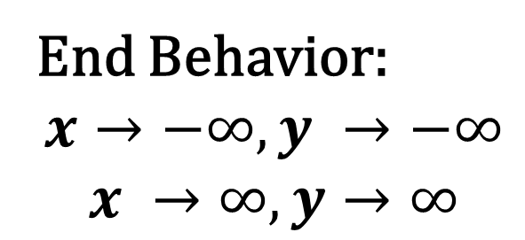


Parent Functions
1. Linear Function
Parent Function Formula:
$$y=x$$
Domain:
Range:
$$(−∞, ∞)$$
$$(−∞, ∞)$$
End Behavior:
$$x→−∞, y →−∞$$
$$x →∞, y→∞$$

Slide 4

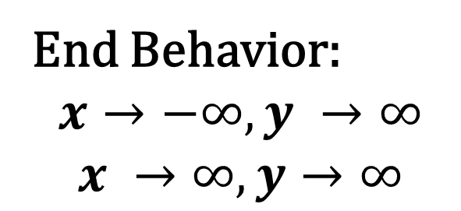


Parent Functions
2. Absolute Value Function
Parent Function Formula:
$$y=\left|x\right|$$
Domain:
Range:
$$(−∞, ∞)$$
$$[0, ∞)$$
End Behavior:
$$x→−∞, y →∞$$
$$x →∞, y→∞$$

Slide 5

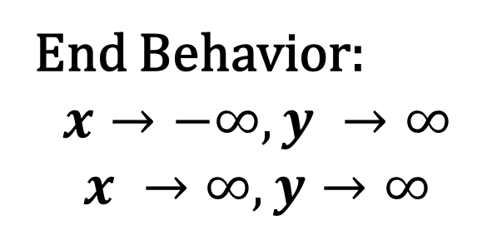


Parent Functions
3. QuadraticFunction
Parent Function Formula:
$$y=x^{2}$$
Domain:
Range:
$$(−∞, ∞)$$
$$[0, ∞)$$
End Behavior:
$$x→−∞, y →∞$$
$$x →∞, y→∞$$

Slide 6

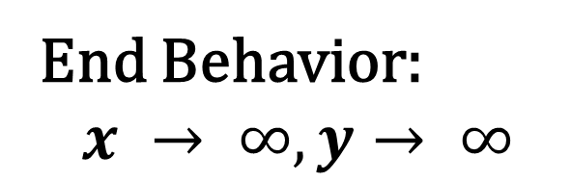


Parent Functions
4. Square Root (Radical) Function
Parent Function Formula:
$$y=\sqrt{x}$$
Domain:
Range:
$$[0 , ∞)$$
$$[0 , ∞)$$
End Behavior:
$$x → ∞, y→ ∞$$

Slide 7

Parent Functions
5. Cubic Function
Parent Function Formula:
$$y=x^{3}$$
Domain:
Range:
$$(−∞, ∞)$$
$$(−∞, ∞)$$
End Behavior:
$$x→−∞, y →−∞$$
$$x →∞, y→∞$$

Slide 8

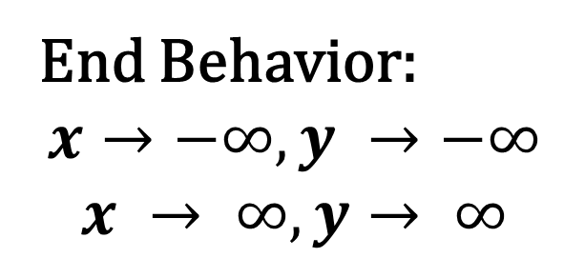


Parent Functions
6. Cube Root Function
Parent Function Formula:
$$y=\sqrt[3]{x}$$
Domain:
Range:
$$(−∞, ∞)$$
$$(−∞, ∞)$$
End Behavior:
$$x→−∞, y →−∞$$
$$x → ∞, y→ ∞$$

Slide 9

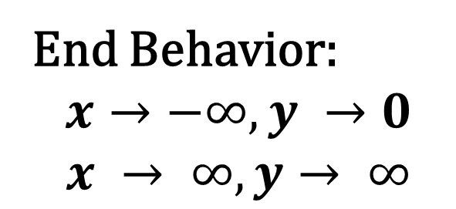


Parent Functions
7. Exponential Function
Parent Function Formula:
$$y=b^{x}$$
Domain:
Range:
$$(−∞, ∞)$$
$$(0, ∞)$$
End Behavior:
$$x→−∞, y →0$$
$$x → ∞, y→ ∞$$

Slide 10

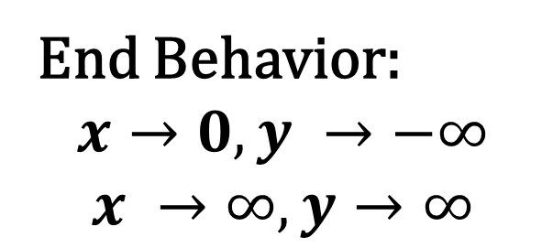

Parent Functions
8. Logarithmic Function
Parent Function Formula:
$$y=\log_{b}{x}$$
Domain:
Range:
$$(0, ∞)$$
$$(−∞, ∞)$$
End Behavior:
$$x→0, y →−∞$$
$$x →∞, y→∞$$

Slide 11
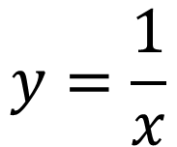
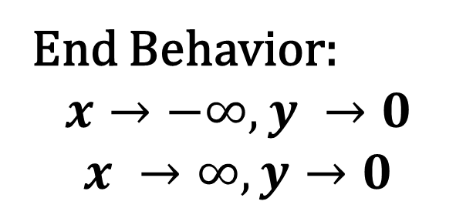


Parent Functions
9. Rational OR Inverse Function
$$y=\frac{1}{x}$$
Parent Function Formula:
Domain:
Range:
$$\left(−∞, 0\right)∪(0, ∞)$$
$$\left(−∞, 0\right)∪(0, ∞)$$
End Behavior:
$$x→−∞, y →0$$
$$x →∞, y→0$$

Slide 12
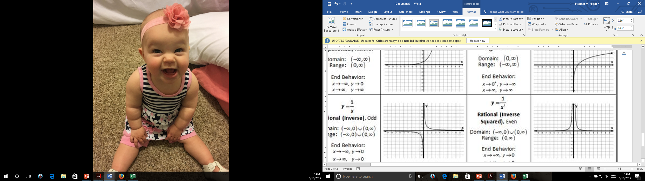
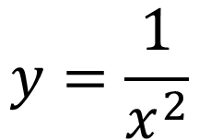

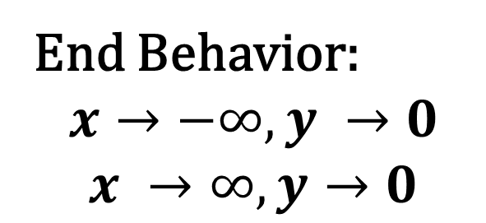
Parent Functions
10. Inverse Squared Function
$$y=\frac{1}{x^{2}}$$
Parent Function Formula:
Domain:
Range:
$$\left(−∞, 0\right)∪(0, ∞)$$
$$(0, ∞)$$
End Behavior:
$$x→−∞, y →0$$
$$x →∞, y→0$$

Slide 13

Parent Functions
Parent Function Formula:
$$y=int\left(x\right)=⟦x⟧$$
11.
Greatest Integer (Step)
Function
The Greatest Integer Function produces the "greatest integer less than or equal to the number" operated upon, symbol [x] or sometimes [[x]].
If the number is an integer, use that integer.
If the number is not an integer, use the next smaller integer.

Slide 14

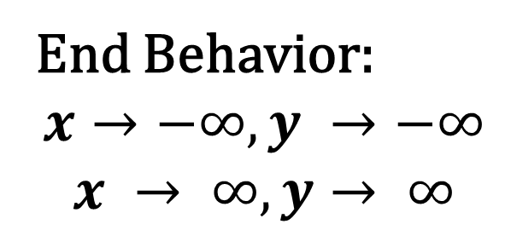
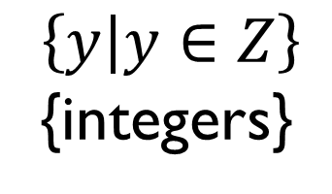

Parent Functions
11. Greatest Integer (Step)Function
Parent Function Formula:
$$y=int\left(x\right)=⟦x⟧$$
Domain:
Range:
$$(−∞, ∞)$$
$$\left\{y | y∈Z\right\}$$
{integers}
End Behavior:
$$x→−∞, y →−∞$$
$$x → ∞, y→ ∞$$

Slide 15

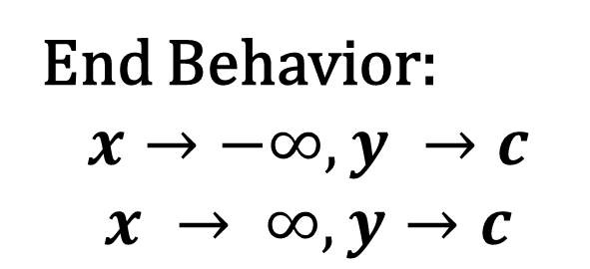

Parent Functions
12. Constant Function
Parent Function Formula:
$$y=c$$
Domain:
Range:
$$(−∞, ∞)$$
$$\{y|y=c\}$$
End Behavior:
$$x→−∞, y →c$$
$$x → ∞, y→c$$

Slide 16
Trigonometric Functions

Slide 17

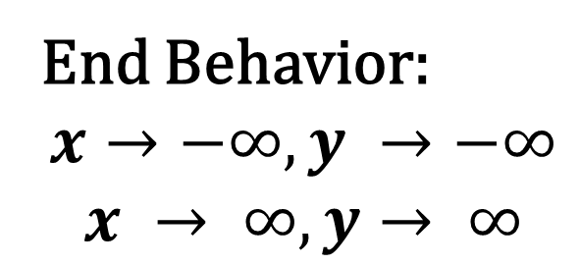

Parent Functions
13. Sine Function
Parent Function Formula:
$$y=\sin{x}$$
$$(−∞, ∞)$$
Domain:
Range:
$$[−1, 1]$$
End Behavior:
$$x→−∞, y →−∞$$
$$x → ∞, y→ ∞$$

Slide 18

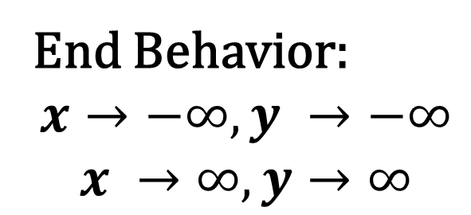
Parent Functions
14. Cosine Function
Parent Function Formula:
$$y=\cos{x}$$
Domain:
Range:
$$(−∞, ∞)$$
[-1, 1]
End Behavior:
$$x→−∞, y →−∞$$
$$x →∞, y→∞$$

Slide 19


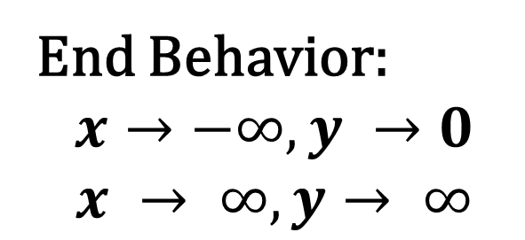

Parent Functions
15. Tangent Function
Parent Function Formula:
$$y=\tan{x}$$
$$(−∞, ∞)$$
Domain:
Range:
$$(−∞, ∞)$$
End Behavior:
$$x→−∞, y →0$$
$$x → ∞, y→ ∞$$

