Slide 1
Objectives: 1. Graph Piecewise Functions 2. Determine if the function is continuous or discontinuous 3. Determine the domain for each piece of the function.

Slide 2
Definition:
A piecewise function is a function that is a combination of one or more functions.
The rule (function) is different for different parts of the domain (x – values).

Slide 3
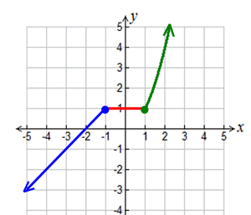
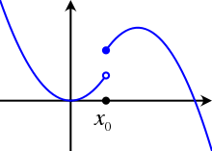
A piecewise function with either be:
Continuous OR discontinuous
(all connected) (disconnected)

Slide 4
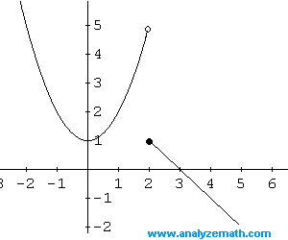
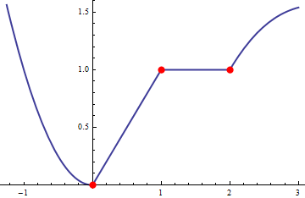
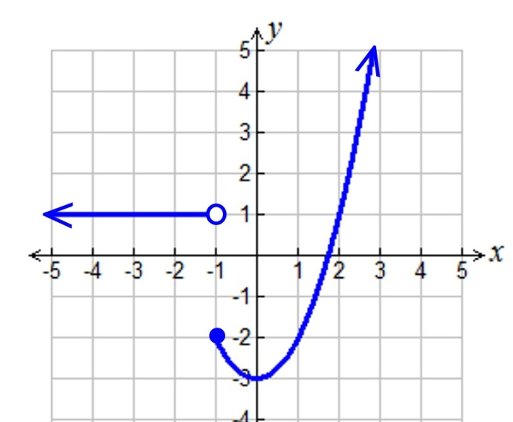
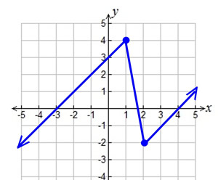
Determine if the following piecewise functions are continuous or discontinuous.
1) 2)
Continuous
Discontinuous
3) 4)
Continuous
Discontinuous

Slide 5
Vertical Line Test
Piecewise functions are functions therefore…. They must pass the VERTICAL LINE TEST!
A.K.A. No vertical line should touch the graph more than once.

Slide 6
Piecewise functions will have open and closed dots.
Remember:
≤ >
≥ <
Included NOT included

Slide 7
For example:
This graph DOES NOT include “5”. It only includes numbers smaller than 5 such as 4, 3, 2, 1, … etc.
The line get’s as close to 5 as possible (i.e. 4.999999999999) but will NEVER touch 5 because of the open dot.

Slide 8
Do these graphs pass the vertical line test???
Yes! The open dot means that point is NOT included. Therefore it only crosses once!

Slide 9
What is the domain?? (x value)
2
2
1
1
x ≤ 0
x < -1
Line 1: _________
Line 2: _________
Line 1: _________
Line 2: _________
x > 0
x ≥ -1

Slide 10
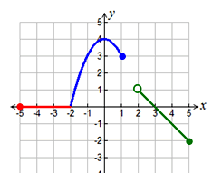
What is the domain?? (x value)
2
1
1
3
2
x < -1
Line 1: _________
Curve 2: ________
-5≤ x ≤ -2
Line 1: _________
Curve 2: _______
Line 3: _________
x ≥ -1
-2 ≤ x ≤ 1
2 < x ≤ 5

Slide 11
Determine where the piecewise function is increasing, decreasing or staying the same.
1)
x > 2
Increasing:
Decreasing:
Stays the same:
0≤ x ≤ 1
x ≤ 0
1 ≤ x ≤ 2

Slide 12
Determine where the piecewise function is increasing, decreasing or staying the same.
2)
Increasing:
Decreasing:
Stays the same:
-2 ≤ x ≤ 0
0 ≤ x ≤ 1
2 <x ≤ 5
-5 ≤ x ≤ -2

Slide 13
Determine where the piecewise function is increasing, decreasing or staying the same.
3)
Increasing:
Decreasing:
Stays the same:
x > 0
-1 ≤ x ≤ 0
x < -1

Slide 14
Evaluating piecewise functions
Sometimes, you’ll be given piecewise functions and asked to evaluate them; in other words, find the y values when you are given an x value.
Example #5: Evaluate f(x) for x = –6 and x = 4
-4
When x = -6, f(-6) = __________
When x= 4, f(4)= ___________
f(x) = 2x+8
f(-6) = 2(-6)+8
16
f(x) = x²
f(4) = (4)²

Slide 15
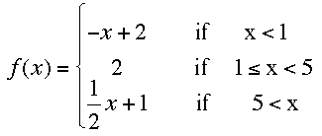
Evaluating piecewise functions
0, -1, -2, -3, ….
1, 2, 3, 4
6, 7, 8, 9, …
6) 7)
Evaluate f(x) when x = 8
Evaluate f(x) when x = 3
f(x) = ½x+1
f(x) = 2
f(8) = ½(8)+1 =
5
f(3) = 2
8)
Evaluate f(x) when x = 10
f(x) = ½x+1
f(x) = ½(10)+1 =
10

Slide 16
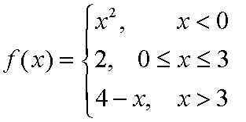
Evaluating piecewise functions
-1, -2, -3, -4 ….
0, 1, 2, 3
4, 5, 6, 7, …
9) 10)
Evaluate f(x) when x = -2
Evaluate f(x) when x = 5
f(x) = x²
f(x) = 4 - x
f(-2) = (-2)²=
4
f(5) = 4 – (5) =
-1
11)
Evaluate f(x) when x = 1
f(x) = 2
f(1) = 2

Slide 17
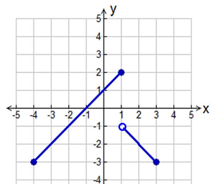
Evaluating piecewise functions
12)
13)
14)
Evaluate f(x) when x = 2
When x =2, f(2)=
-2
Evaluate f(x) when x = -3
When x =-3, f(-3)=
-2
Evaluate f(x) when x = 1
When x =1, f(1)=
2

Slide 18
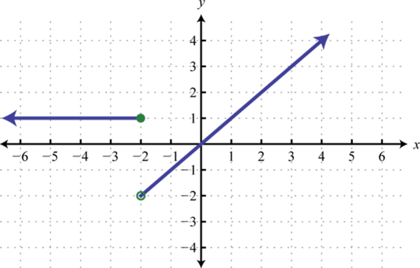
Evaluating piecewise functions
15)
16)
Evaluate f(x) when x = 4
When x =4, f(4)=
4
Evaluate f(x) when x = -3
When x = -3, f(-3)=
1
17)
Evaluate f(x) when x = -2
When x = -2, f(-2)=
1

Slide 19
Piecewise Practice HW – 2nd, 6th, 7th need to finish:

Slide 20
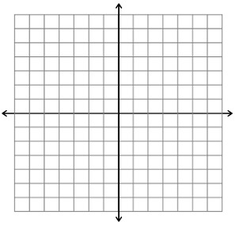
Graphing piecewise functions
18)
x | y
x | y
OPEN
-2
-1
0
1
1
-2
-3
-4
-5
1
0
0
-1
-1
-2
-2

Slide 21
Graphing piecewise functions
19)
x | y
x | y
x | y
OPEN
1
0
-1
-2
5
1
2
3
4
2
4
5
6
7
-1
4
2
0
3
2
1
2
2
2
OPEN

Slide 22
Graphing piecewise functions
20)
x | y
x | y
x | y
OPEN
OPEN
0
-1
-2
-3
3
0
1
2
3
2
3
4
5
3
2
3
5
1
3
7
0
9

Slide 23
Objectives: 1. Graph Step Functions 2. Evaluate Step Functions 3. Determine the domain of Step Functions

Slide 24
Definition:
A step function (or staircase function) is a piecewise function containing all constant "pieces".
All step functions are discontinuous (not continuous).
You cannot draw a step function without removing your pencil from your paper.

Slide 25
What is the domain (x) for each step in the function?
x > 0
-4 ≤ x < -1
Top: _____________
Middle: __________
Bottom: _________
Left: _____________
Middle: __________
Right: _________
x = 0
-1 ≤ x ≤ 2
x < 0
2 < x ≤ 5

Slide 26
Evaluating Step Functions
Sometimes, you’ll be given a step function and asked to evaluate it; in other words, find the y values when you are given an x value.
1. Evaluate when x = -4
2. Evaluate when x = 0
3. Evaluate when x = 5
1, 2, 3, …
f(x) = -1
0
f(-4) = -1
-1, -2, -3, …
f(x) = 0
f(0) = 0
f(x) =1
f(5) = 1

Slide 27
Evaluating Step Functions
-4, -3, -2
-4, -3, -2
-1, 0, 1
-1, 0, 1, 2
2, 3, 4
3, 4, 5
4. Evaluate when x = 3
5. Evaluate when x = 0
6. Evaluate when x = -2
7. Evaluate when x = -1
8. Evaluate when x = 1
9. Evaluate when x = 3
f(x) = -3
f(x) = 2
f(3) = -3
f(-1) = 2
f(x) = 2
f(x) = 2
f(0) = 2
f(-1) = 2
f(x) = 4
f(x) = -1
f(-2) = 4
f(3) = -1

Slide 28
Evaluating Step Functions
10. Evaluate when x = -6
11. Evaluate when x = 0
12. Evaluate when x = 1
13. Evaluate when x = -1
14. Evaluate when x = 2
15. Evaluate when x = -3
When x = -6, f(-6) =
-1
When x = -1, f(-1) =
2
When x = 2, f(2) =
When x = 0, f(0) =
2
1
When x = 1, f(1) =
When x = -3, f(-3) =
-1
1

Slide 29
Graphing Step Functions
16)
x | y
x | y
x | y
-2
-1
0
5
5
5
0
1
2
3
3
3
2
3
4
1
1
1
OPEN
OPEN
OPEN

Slide 30
Graphing Step Functions
17)
x | y
x | y
x | y
-5
-4
-3
-2
-1
7
7
7
7
7
-1
0
1
2
3
3
3
3
3
3
3
4
5
6
7
-1
-1
-1
-1
-1
OPEN
OPEN
OPEN

Slide 31
Graphing Step Functions
18)
x | y
x | y
x | y
0
1
2
3
8
8
8
8
3
4
5
6
5
5
5
5
6
7
8
9
2
2
2
2
OPEN
OPEN
OPEN

