Slide 1
Objective:
Interpret Scatterplots & Use them to Make Predictions

Slide 2
Correlation
Definitions:
Correlation
A measure of association between two numerical variables.
Notes:
Typically, in the summer as the temperature increases people are thirstier. Consider the two numerical variables, temperature and water consumption. We would expect the higher the temperature, the more water a given person would consume. Thus we would say that in the summer time, temperature and water consumption are positively correlated.

Slide 3
Scatter Plots show a positive trend (correlation) if as y increases, x increases.
Example: As the temperature increases in the summer, the thirstier people tend to get.
Scatter Plots show a negative trend (correlation) if one increases while the other decreases.
Example: The more hours you study, the less questions missed on a test.
A scatter plot shows no trend (correlation) if there is no obvious pattern.

Slide 4
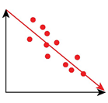
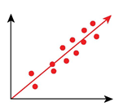
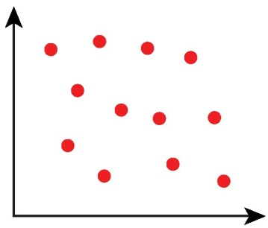
NEGATIVE
POSITIVE
NO CORRELATION

Slide 5
Measuring the Relationship
Correlation Coefficient, r
The Correlation Coefficient measures the direction and the strength of the linear association between two numerical paired variables.

Slide 6
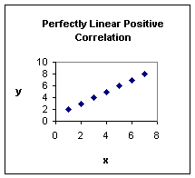
Measuring the Relationship
Correlation Coefficient, r
“r” can be any number between 1 and -1.
“1” represents a PERFECTLY LINEAR POSITIVE correlation.
“-1” represents a PERFECTLY LINEAR NEGATIVE correlation.
r = 1

Slide 7
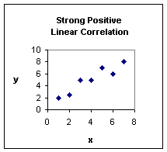
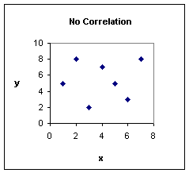
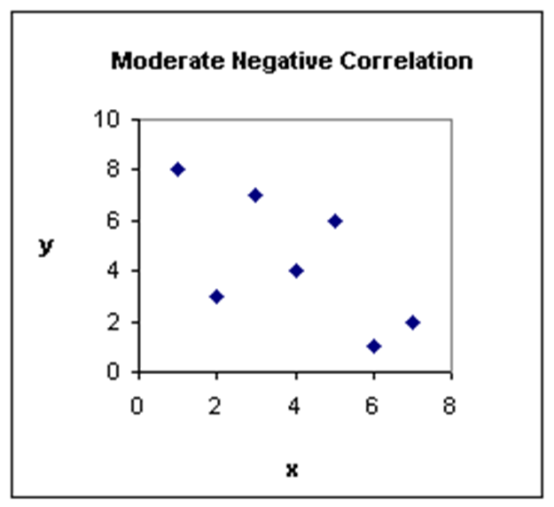
Measuring the Relationship
Correlation Coefficient, r
The closer the decimal is to 1 or -1 the stronger the relationship.
The closer the decimal is to 0 the weaker the relationship.
r = 0.8
r = 0
r = -0.5

Slide 8
If there is a trend we can use a REGRESSION LINE or line of best fit to make predictions.
A line of best fit should be drawn through the middle of the data as best you can.
Everyone’s line of best fit will be a little bit different… that’s okay.

Slide 9
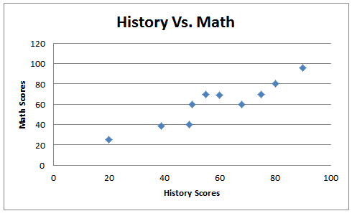
History Vs. Math
Is there a relationship between the scores?
Describe the relationship.
Yes
Positive (moderate to strong)

Slide 10
History Vs. Math
Draw a line of best fit.
Predict what a student who earned a 75% on their history test earned on their math test.

Slide 11
History Vs. Math
75% on History Test
What score would he get on the math test?
About 77%

Slide 12
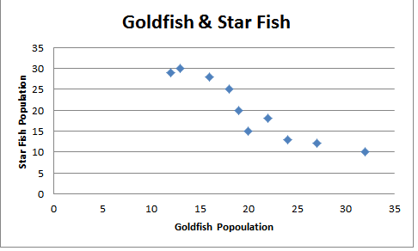
Population of Goldfish & Star fish
Is there a relationship with this data?
What kind of relationship is it?
yes
Negative (moderate to strong)

Slide 13
Goldfish & Star Fish
Draw a line of best fit.
If I have a goldfish population of 15, how many star fish will there be?
There would be about 26 star fish.

Slide 14
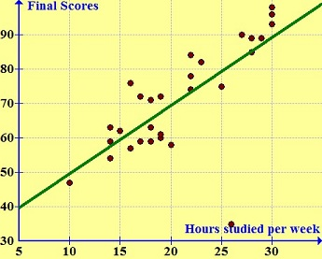
The graph shows the relationship between the number of hours a student studied for a test and their final score.
What type of relationship is this?
What does that mean in context?
Predict a students score if they studied 10 hours per week?
Predict a students score if they studied 25 hours per week?
Positive (moderate)
The more you study – the better your final grade.
50%
80%

Slide 15
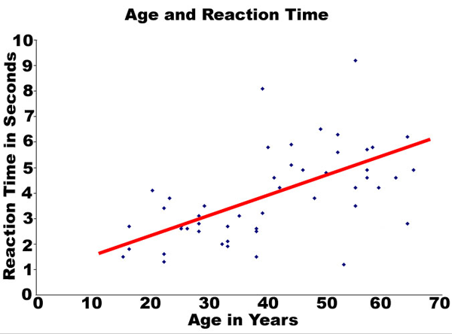
The graph shows the relationship between a persons age and their reaction time while driving.
What type of relationship is this?
Meaning?
Predict a persons reaction time if they are 30 years old?
Predict a person’s reaction time if they are 60 years old?

Slide 16
Correlation Coefficient on the Calculator!

Slide 20
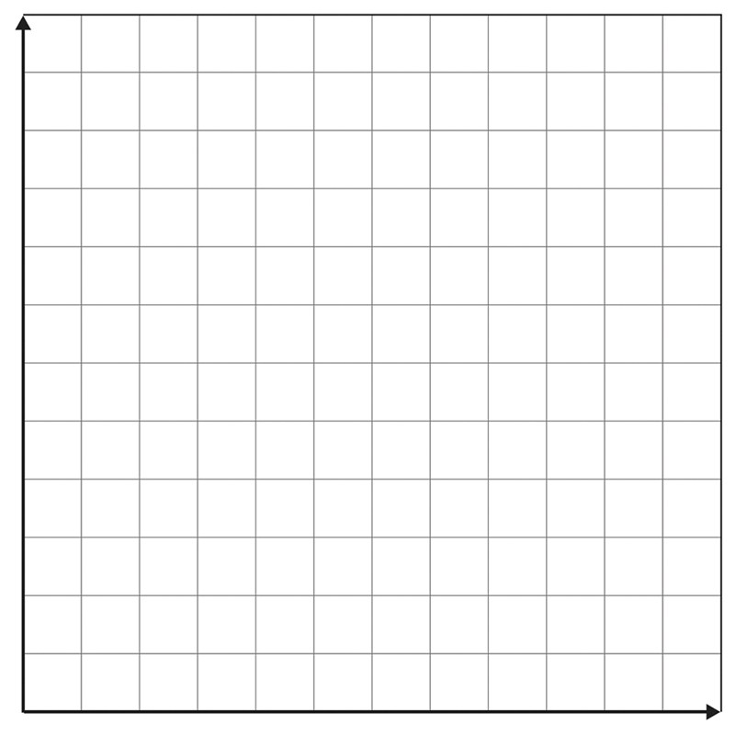
https://im.openupresources.org/6/students/7/11.html

Slide 21
H = 2.91L + 54.04

Slide 22
Strong positive

Slide 25
y = -0.15x + 47.5

Slide 26
Interpreting the data

Slide 29
The correlation coefficient is ___________________________.
The equation of the line of best fit is _____________________________.

Slide 30
