Slide 1
Objectives: 1. Identify systems of equations 2. Determine solutions to a system of equations. 3. Solve systems of equations by GRAPHING
6-1

Slide 2
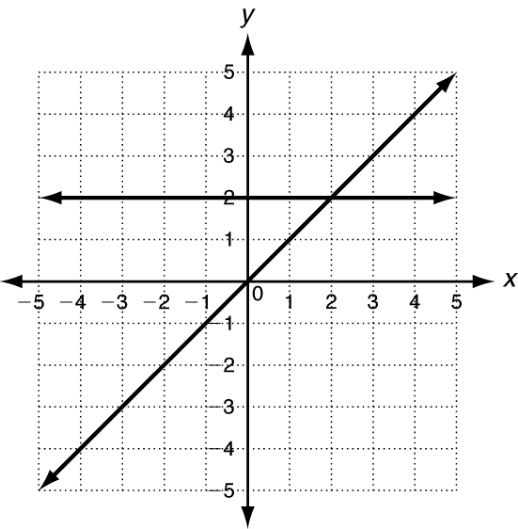
6-1
System of equations: 2 linear equations together.
The solution to a system of equations is an ordered pair (x,y) where the two lines intersect (cross)
Example:
The solution to the system
Graphed to the right is (2,2)

Slide 3
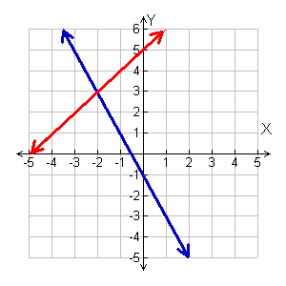
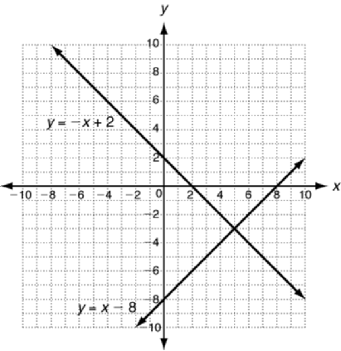
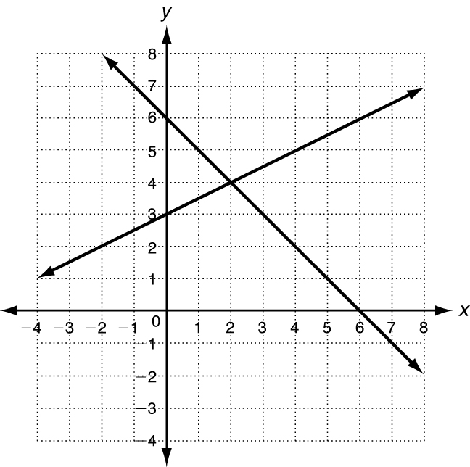
Practice
6-1
Determine the solution to the system of equations.
1) 2) 3)
(2, 4)
(-2, 3)
(5, -3)

Slide 4
6-1
A solution to a system of equations makes BOTH statements true.
Meaning: If you plug in that ordered pair to both equations for x and y then the left side will equal the right side.

Slide 5
6-1
Tell whether the ordered pair is
a solution of the given system.
3)
(5, 2);
3x – y = 13
3x – y 13
0
3(5) – 2 13
2 – 2 0
15 – 2 13
✓
0 0
13 13
✓
The ordered pair (5, 2) makes both equations true.
(5, 2) is the solution of the system.

Slide 6
6-1
Tell whether the ordered pair is
a solution of the given system.
4)
x + 3y = 4
(–2, 2);
–x + y = 2
x + 3y = 4
–x + y = 2
–2 + 3(2) 4
–(–2) + 2 2
–2 + 6 4
4 2
4 4
✓
The ordered pair (–2, 2) makes one equation true but not the other.
(–2, 2) is not a solution of the system.

Slide 7
6-1
Tell whether the ordered pair is
a solution of the given system.
5)
(1, 3);
2x + y = 5
–2x + y = 1
2x + y = 5
–2x + y = 1
2(1) + 3 5
–2(1) + 3 1
2 + 3 5
–2 + 3 1
✓
✓
5 5
1 1
The ordered pair (1, 3) makes both equations true.
(1, 3) is the solution of the system.

Slide 8
6-1
Tell whether the ordered pair is
a solution of the given system.
6)
(2, –1);
x – 2y = 4
3x + y = 6
x – 2y = 4
3x + y = 6
2 – 2(–1) 4
3(2) + (–1) 6
2 + 2 4
6 – 1 6
4 4
✓
5 6
The ordered pair (2, –1) makes one equation true, but not the other.
(2, –1) is not a solution of the system.

Slide 9
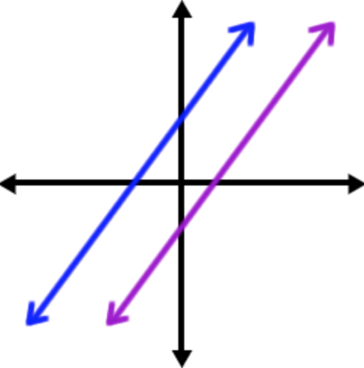
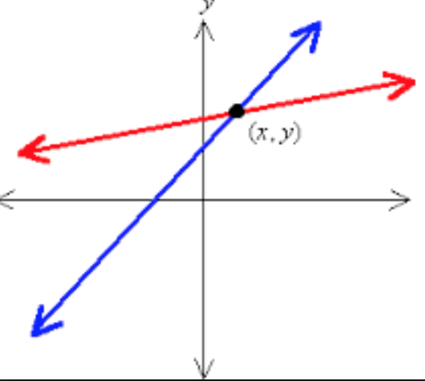
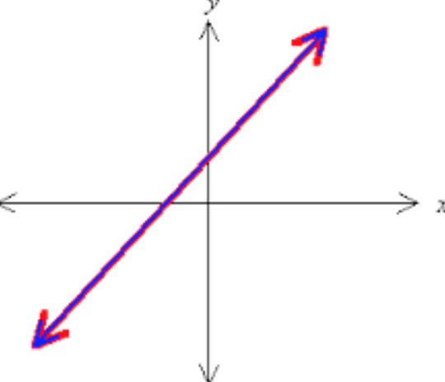
6-1
The number of solutions that the system of equations has can be determined by looking at the graph:
PARALLEL LINES never cross!
NO SOLUTION!
INTERSECTING LINES
ONE SOLUTION.
SAME LINE
INFINITE SOLUTIONS.

Slide 10
6-1
REVIEW:
GRAPHING A LINEAR EQUATION.
Steps:
Put equation in slope intercept form:
y = mx + b
Plot the y intercept
Use the slope to find another point
Connect the dots and extend the lines!

Slide 11
6-1
Graph each system of equations.
Determine the number of solutions.
If the system has one solution, name it.
7)

Slide 12
6-1
Graph each system of equations.
Determine the number of solutions.
If the system has one solution, name it.
8)

Slide 13
6-1
Graph each system of equations.
Determine the number of solutions.
If the system has one solution, name it.
9)

Slide 14
6-1
Graph each system of equations.
Determine the number of solutions.
If the system has one solution, name it.
10)

Slide 15
6-1
Graph each system of equations.
Determine the number of solutions.
If the system has one solution, name it.
11)

Slide 16
6-1
Graph each system of equations.
Determine the number of solutions.
If the system has one solution, name it.
12)

Slide 17
End Day 1!

Slide 18
Review from yesterday
Graph the following. Determine the number of solutions. If there is ONE solution you must name it.
1) 2)
3) 4)

Slide 19
Review from yesterday
Determine if the following ordered pair is a solution:
6)
5)

Slide 20
Review from yesterday
7)
8)

Slide 21
To find the INTERSECTION of two functions
6-1
Click on “Y=”
Type in equations
Click “2nd” → Click “TRACE” calc
Scroll down to “Intersect” #5
It will say “first curve” → Move curser anywhere on the first line → ENTER
It will say “second curve” → Move curser anywhere on the second line → ENTER
It will say “GUESS” → ENTER
Answer is at the bottom of the screen

Slide 22
6-1
Find the solution to the system of equations
1) 2)
3) 4)

Slide 23
Write the equation of line 1:
Write the equation of line 2:
Write the solution to the system of equations:
2
1

Slide 24
4. The graph of $y=\frac{2}{5}x+3$ is shown. Draw a line with a y-intercept of (0,-3) that would create a system with a solution of (5,5).

Slide 26
6. Write the equation of line 1:
7. Write the equation of line 2:
8. Write the solution to the system of equations:

Slide 27
9. The graph of $y=4x=5$ is shown. Draw a line with a slope of -1/2 that would create a system with a solution of (-1,-9).

